Slide 1
Zero-Dimensional Nanostructures: Nanoparticles
Synthesis of Nanoparticles
Semana 5

Slide 2
Oxide nanoparticles
Typically attained by the sol gel process:
  Wet chemical process
  Synthesis of colloidal dispersions for both:
    inorganic and organic-inorganic hybrid materials
  Advantages:
    low processing temperature
    molecular homogeneity
  Two basic steps:
    hydrolysis
    condensation

Slide 3
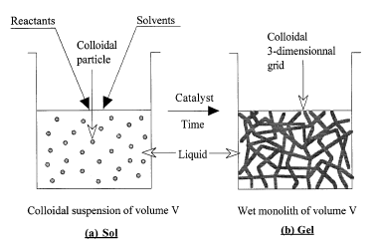
Nanocrystalline Metal Oxide Preparation
Sol-Gel Process
Solid materials synthesis procedure, performed in a liquid and normally at low temperatures
Particles in a dispersed state in the solvent– independent colloidal suspension–Sol
The colloidal particles are linked together to form a 3-dimensional open grid–Gel
Sol Gel
Gelation process

Slide 4
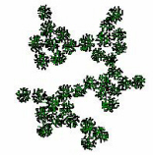
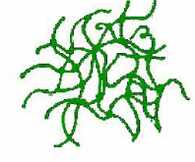
Nanocrystalline Metal Oxide Preparation
Sol-Gel Process
Two types of gels depending on the rate of gelation process
Colloidal Gels – hydrolysis rate is slow and condensation rate is slow
Polymeric Gels (no formation of intermediate occurrence of individual particles) - hydrolysis rate is fast and condensation rate is slow
Controlled Precipitation - hydrolysis rate is slow and condensation reactions are fast
Gelatinous Precipitation – both hydrolysis and condensation reactions are fast

Slide 5
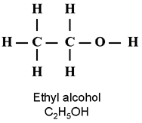
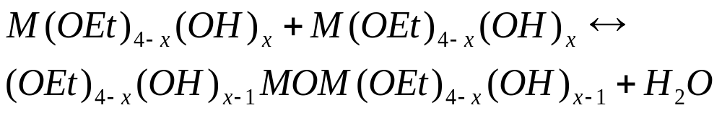
Sol-gel steps
Hydrolysis
Condensation of precursors
Typical precursors:
  metal alkoxides or inorganic and organic salts
OEt is
OEt is
Etoxi group
M could be. Si, Ti, Sn, etc.
If Si then:
Si
Spatially, the Si is at the center of a pyramid with an Etoxi group at each vertex

Slide 6
Hydrolysis
Si
+ H₂0
Si
-OH
+
-H
The hydrolysis of the TEOS molecules can result in Si(OH)₄ but all depends on the relative concentration of H₂0 to TEOS and the velocity of the reaction. At the same time condensation of mono-hydrolyzed TEOS can react to produce dimers…
Condensation of precursors
Si
-O-
Si
Si
-OH
+
-OH
Si
+ H₂0
The dimers can be hydrolyzed by other H₂O molecules attacking any of the EtO positions and create a network growing in every direction….

Slide 7

Ethanol is formed every time an OH group is created. The Si linked to the OH group. The OH groups react to form water and make the Si atoms to be connected through an Oxygen
Si
-O-
Si
This is a random process and the chemical reaction and the porosity is controlled by:
the relative concentration of H₂0/TEOS,
the kinetics of the reaction, that can be altered by
  the use of a catalyst), and/or
  Temperature
The presence of surfactant (like soap)
-O-
-O-
Si
Si
-O-
Si
-O-
-O-
Si
-O-
Si
Si
-O-
-O-
-O-
Si
If you visualize
this in 3D you can ”see” that a porous structure is being created
Si

Slide 8
Multicomponent materials
Sol-gel route
  ensures hetero-condensation reactions between different constituent precursors:
    to be considered:
      reactivity, electronegativity, coordination number, ionic radius
    precursor modification:
      attaching different organic ligands (e.g. reactivity: Si(OC₂H₅)₄ < Si(OCH₃)₄) )
    chemically modify the coordination state of the alkoxides
    multiple step sol-gel

Slide 9
Organic-inorganic hybrids
Incorporating organic components into an oxide system by sol-gel processing
  co-polymerization
  co-condense
  trap the desired organic (or bio) components inside the network
  biocomponents-organic-inorganic hybrids

Slide 10
Sol-gel products
Monodispersed nanoparticles
  temporal nucleation followed by diffusion-controlled growth
  complex oxides, organic-inorganic hybrids, biomaterials
  size=f (concentration, aging time)
  colloid stabilization: not by polymer steric barrier but by electrostatic double layer

Slide 11
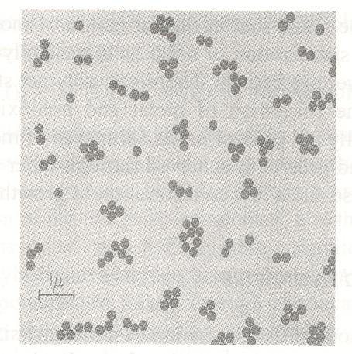
Sol-gel example: silica
Precursors:
  silicone alkoxides with different
  alkyl ligand sizes
catalyst:
  ammonia
solvent:
  various alcohols
Vigorous stirring
water

Slide 12
Nanocrystalline Metal Oxide Preparation
Sol-Gel Process
Inorganic gels
SiO₂, TiO₂, ZrO₂, Mg(OH)₂ etc.
Organic gels
-(C-C)- covalent bonds
resorcinol-formaldehyde (RF),
Melamine formaldehyde
Carbon gels
Organic gels heat at 500 ºC in N₂ → C gel

Slide 13
Nanocrystalline Metal Oxide Preparation
Sol-Gel Process
The usual molecular precursors are metallo-organic compounds such as
alkoxides M(OR)_{n}, where
M is a metal like Si, Ti, etc.
R is an alkyl group (R = CH₃, C₂H₅, etc.)
Tetraethylorthosilicate (TEOS),
Si(OC₂H₅)₄,
is commonly used in the sol–gel synthesis of silica and glasses.

Slide 14
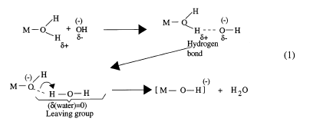
Metal Salt (MX_{n}) as precursor
Hydrolysis reaction
M^{z+} + H₂O → M(OH₂)^{z+}
H₂O groups are replaced by OH (loss of proton)

Slide 15
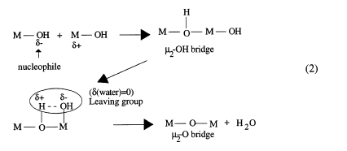
Metal Salt (MX_{n}) as precursor
Condensation reaction
H₂O groups are eliminated

Slide 16
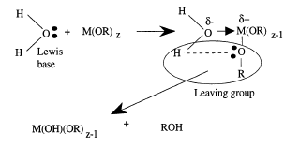
Hydrolysis Mechanism

Slide 17
Nanocrystalline Metal Oxide Preparation
Sol-Gel Process
General equation:
Ti(OC₃H₇)₄ + 4 H₂O TiO₂ + 4 C₃H₇OH
Hydrolysis (Initiation)
Ethanol/Methanol, Catalyst
Ti(^{i}OC₃H₇)₄ + x H₂O Ti(^{i}OC₃H₇)_{4 –x}(OH)_{x}+ x C₃H₇OH
“Titanol”

Slide 18

Nanocrystalline Metal Oxide Preparation
Sol-Gel Process
Condensation (Propagation)
Ti(^{i}OC₃H₇)_{4 –x}(OH)_{x} + Ti(^{i}OC₃H₇)_{4 –x}(OH)_{x}
Ti(^{i}OC₃H₇)_{4 –x}(OH)_{x -1}OTi(OH)_{x-1}(OC₃H₇)_{4-x} + H₂O
Reaction Mecanism

Slide 19
Application
TiO₂ and Energy

Slide 20
Solar Energy
World demand for energy is projected to more than double by 2050 and to more than triple by the end of the century.
More energy from sunlight strikes the Earth in one hour (4.3 × 10²⁰ J) than all the energy consumed on the planet in a year (4.1 × 10²⁰ J).
In 2001, solar electricity provided less than 0.1% of the world's electricity, and solar fuel from modern (sustainable) biomass provided less than 1.5% of the world's energy.
Solar electricity from photovoltaics is too costly, by factors of 5–10, to compete with fossil-derived electricity.
Solar energy has enormous promise as a clean, abundant, economical energy source.
Research challenges exist in designing materials and in understanding the electronic and molecular basis of capture, conversion, and storage before its promise can be realized.
Report on the Basic Energy Sciences Workshop on Solar Energy Utilization
April 18-21, 2005, Bethesda, Maryland

Slide 21
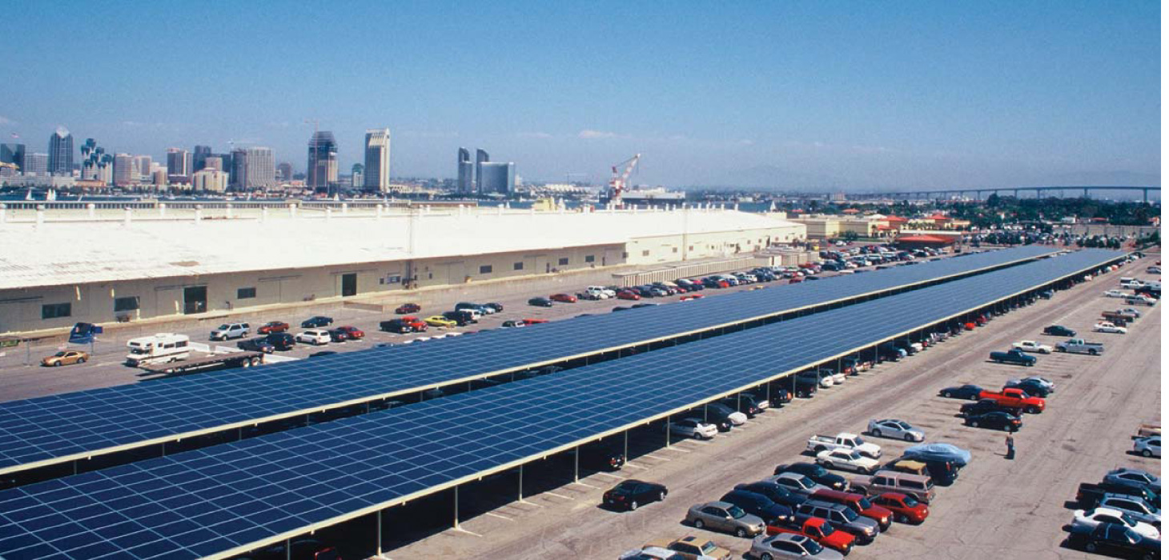
Automobiles were disruptive to the horse and buggy business. PCs were disruptive to the typewriter industry. We believe solar electric systems will be disruptive to the energy industry.
Daniel Shugar, PowerLight Corporation, in National Geographic, August 2005
Photovoltaics
Crystalline Silicon Solar Cells
Advantages
• Raw material is abundant, durable,
environmentally benign
• 22% efficiency (incoming light to
electricity)
Disadvantages
• Producing high purity silicon is expensive
• Low absorptivity (100 µm thick is heavy
and rigid)
• High demand for computer chips raises
price ($100/kg)
• $3-$5/watt
http://www.mrsec.wisc.edu/Edetc/SlideShow/slides/pn_junction/crystalline.html
by Ranjit T. Koodal. University of South Dakota

Slide 22
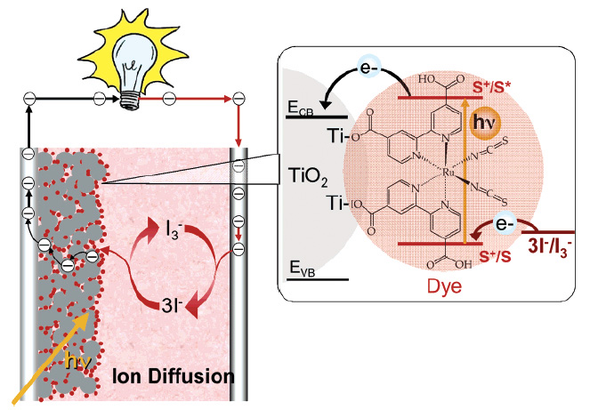
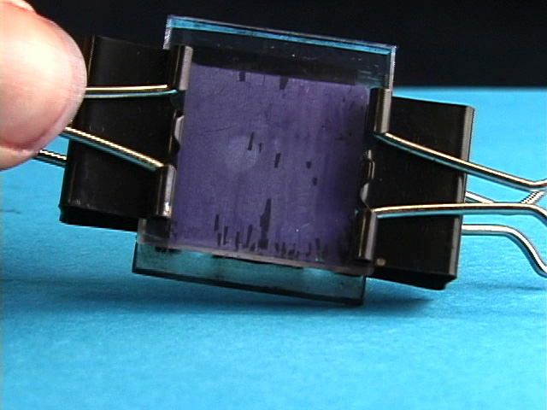
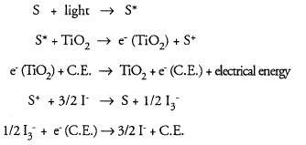
TiO₂ Based Dye Sensitized Solar Cell
http://www.mrsec.wisc.edu/Edetc/SlideShow/slides/TiO2/gratzel_E.html

Slide 23
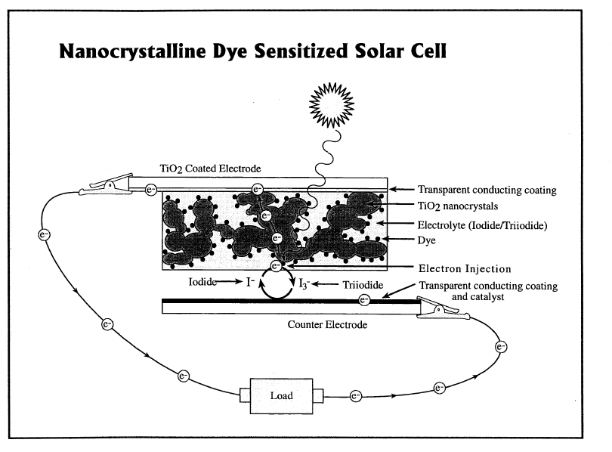
TiO₂ Dye Sensitized Solar Cell
by Ranjit T. Koodal. University of South Dakota

Slide 24
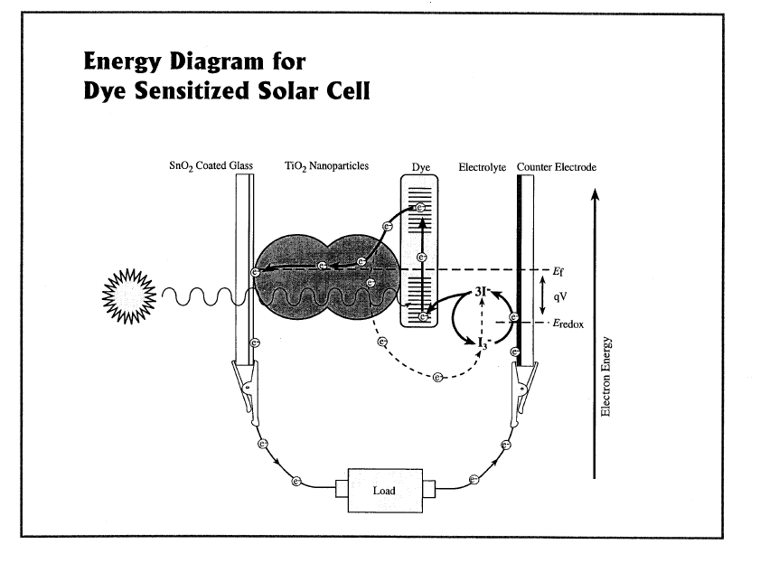
TiO₂ Dye Sensitized Solar Cell

Slide 25
TiO₂ Dye Sensitized Solar Cell
Glossary of Terms
Absorption (usually of light) One of the possible fates of light when it interacts with matter
Adsorption Binding of a substance to the surface of a material.
Charge Measure of strength of a body by which it can interact electrostatically with another body
Chlorophyll Dye/Pigment that is used by living plants to convert light energy into chemicals.
Colloid Small particles (< 100 nm)
Colloidal suspension Collection of small particles in a liquid, e.g. milk
Counter Electrode The electrode at which the electrochemical circuit is completed
Current Rate of supply of charge (Amperes, A)
Diffusion Flow of molecules from one part(high concentration to another (i.e. low concentration)
Dye Chemical compounds that can absorb light
Electrode A solid that is in contact with an electrolyte in a electrochemical cell so that current can flow
Electrolyte An ionically conducting medium
Electron Transfer Movement of electrons from one substance to another
Energy Capacity to do work
Iodide Element present in sea water (functions as mediator in DSSC)
Ion Electrically charged atom or groups of atom

Slide 26
TiO₂ Dye Sensitized Solar Cell
Glossary of Terms
17. Mediator Molecule that maintains, and protects the electrical charge on another substance by being reduced or oxidized
18.Nano One Billionth of a meter
19.Nanocrystalline A material made up of tiny regions in the range of 1-100 nm.
20.Oxidation A reaction in which an atom, an ion or a molecule loses an electron
21.Photoelectrochemical Cell A device in which light driven reaction induces electron to travel from one substance to another
22.Photon Packet of electromagnetic radiation
23.Photosynthesis Process by which plants use the energy from light to synthesize compounds for their growth from carbon dioxide and water
24.Photovoltaic Cell A device that converts light energy into electricity
25.Reduction A reaction in which an atom/ion or a molecule gains an electron
26.Semiconductor A solid that normally does not conduct electricity, its electrical resistance decreases as temperature is raised
27. Sensitization The process by which a transparent substance is made to absorb light
28. Solar Cell A device that can convert light energy into electrical/chemical energy
29. Suspension A dispersion of small particles on a macroscopic scale
30. Tin Dioxide An oxide material of Tin (Sn) that is electrically conductive and optically transparent
31.Titanium Dioxide An oxide material of Ti metal that is used as a white pigment in paint, salads, lip sticks, etc.
32.Voltage A measure of the difference in electrical potential energy between two electrodes or points.

Slide 27
TiO₂ Dye Sensitized Solar Cell
(http://www.mrsec.wisc.edu/Edetc/nanolab/TiO2/index.html)
Preparing the TiO₂ suspension.
Deposition of the TiO₂ film.
Staining the TiO₂ with Dye.
Carbon coating the counter electrode
Assembling the Solar Cell Device
Measuring the Voltage Output
by Ranjit T. Koodal. University of South Dakota

Slide 28
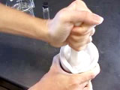
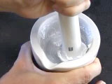
TiO₂ Dye Sensitized Solar Cell
(http://www.mrsec.wisc.edu/Edetc/nanolab/TiO2/index.html)
Preparing the TiO₂ suspension.
Grind about 2-3 grams of nanocrystalline titanium dioxide (TiO₂) in a mortar and pestle with a few drops of very dilute acetic acid. Alternate grinding and addition of a few drops of very dilute acetic acid until you obtain a colloidal suspension with a smooth consistency, somewhat like latex paint.
(Very dilute acetic acid is prepared by adding 0.1 mL concentrated acetic acid to 50 mL of water.)
One batch will use TiO₂ sample labeled Degussa P25, another batch will use TiO₂ sample labeled Acros and another batch will use TiO₂ sample labeled Alfa.
Add a few drops of Triton X-100 surfactant or clear dishwashing detergent and mix some more.

Slide 29
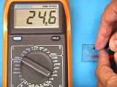
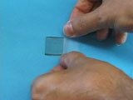
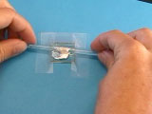
TiO₂ Dye Sensitized Solar Cell
(http://www.mrsec.wisc.edu/Edetc/nanolab/TiO2/index.html)
2. Deposition of the TiO₂ film.
Identify the conducting side of a tin oxide-coated piece of glass by using a multimeter to measure resistance. The conducting side will have a resistance of 20-30 ohms.
With the conducting side up, tape the glass on three sides using one thickness of tape. Wipe off any fingerprints or oils using a tissue wet with ethanol.
Add some of the titanium dioxide suspension and quickly spread using a glass rod. The tape serves as a 40-50 micrometer spacer to control the thickness of the titanium dioxide layer. (If the layer dries out, add more water.)

Slide 30
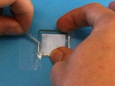
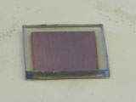
TiO₂ Dye Sensitized Solar Cell
(http://www.mrsec.wisc.edu/Edetc/nanolab/TiO2/index.html)
2. Deposition of the TiO₂ film.
Carefully remove the tape without scratching the TiO₂ coating
Heat the glass on a hotplate in a hood for 10-20 minutes. The surface turns brown as the organic solvent and surfactant dries and burns off to produce a white or green titanium dioxide coating.(Note: this requires a plate that gets quite hot.) Allow the glass to slowly cool by turning off the hotplate.

Slide 31
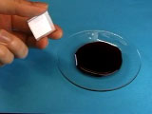
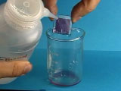
TiO₂ Dye Sensitized Solar Cell
(http://www.mrsec.wisc.edu/Edetc/nanolab/TiO2/index.html)
3. Staining the TiO₂ with Dye.
Immerse the coating in a source of anthocyanins, such as raspberry juice. The raspberry juice may be obtained most easily from frozen raspberries. (Blackberries, pomegranate seeds, and Bing cherries can also be used.)
The white TiO₂ will change color as the dye is absorbed and complexed to the Ti(IV).
Rinse gently with water and then with ethanol. (The ethanol serves to remove water from the porous TiO₂.)

Slide 32
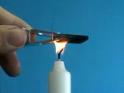
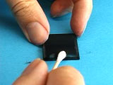
TiO₂ Dye Sensitized Solar Cell
(http://www.mrsec.wisc.edu/Edetc/nanolab/TiO2/index.html)
4. Carbon coating the counter electrode
Pass a second piece of tin oxide glass, conducting side down, through a candle flame to coat the conducting side with carbon (soot).
Alternately, use a graphite pencil to coat the glass piece. For best results, pass the glass piece quickly and repeatedly through the middle part of the flame.
Wipe off the carbon along the perimeter of three sides of the carbon-coated glass plate using a cotton swab.

Slide 33
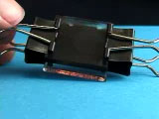
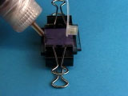
TiO₂ Dye Sensitized Solar Cell
(http://www.mrsec.wisc.edu/Edetc/nanolab/TiO2/index.html)
5. Assembling the Solar Cell Device
Assemble the two glass plates with coated sides together, but offset so that uncoated glass extends beyond the sandwich. Do not rub or slide the plates. Clamp the plates together.
Add a few drops of a triiodide solution to the edge of the plate. Capillary action will cause the KI₃ solution to travel between the two plates.
(The KI₃ electrolyte solution consists of 0.5 M KI and 0.05 M I₂ in anhydrous ethylene glycol.)

Slide 34
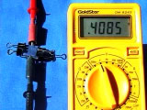
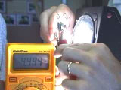
TiO₂ Dye Sensitized Solar Cell
(http://www.mrsec.wisc.edu/Edetc/nanolab/TiO2/index.html)
6. Measuring the Voltage Output
Connect a multimeter using an alligator clip to each plate (the negative electrode is the TiO₂ coated glass and the positive electrode is the carbon coated glass).
Test the current and voltage produced by solar illumination, or test the current and voltage produced by illumination from an overhead projector.

Slide 35
TiO₂ Dye Sensitized Solar Cell
(http://www.mrsec.wisc.edu/Edetc/nanolab/TiO2/index.html)
Observations
Nanocrystalline TiO₂ Cell Output (V)
Group A (Degussa) 0.38 V
Group B (Degussa) 0.43 V
Group C (Degussa) 0.40 V

